Slide 1
Module-08: Part-2: Understanding Recursion
CS 1714 – Computer Programming II

Slide 2
A Stack Frame
Each time a function is called, the stack frame (a set of local variables) are placed on a call stack.
When we are done with a function, we remove it off the stack
The last function called is on top of the call stack.
main()
local variables, parameters, return address
In our representation, the top of the stack is at the top of the image. Other representations show the stack growing down.

Slide 3
A Stack Frame
doSomething()
local variables, parameters, return address
In this example, the main() has called a function named doSomething().
When doSomething() is finished, it will be removed from the stack.
main()
local variables, parameters, return address

Slide 4

Question
What does this call stack imply?
printRecord()
printAllRecords()
main()

Slide 5
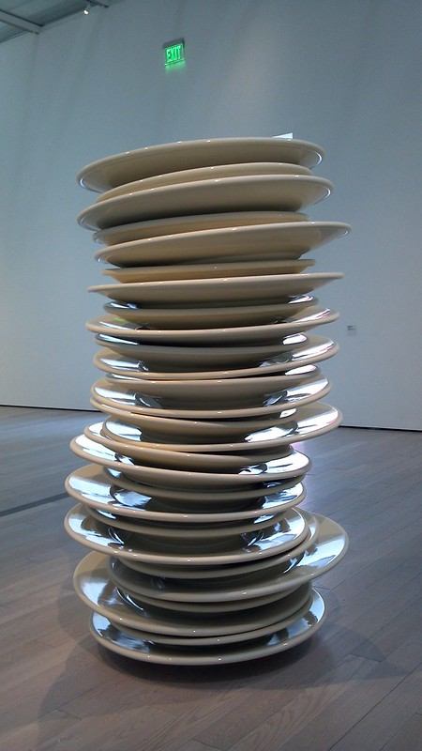
Tracing out a Recursive Function
When tracing out a recursive function, you need to know when the function is still in progress or completed. Visually representing the call stack is important because there may be many stack frames with the same function name
When we call a function, we push (add) it on the stack and keep it there until it's completely done.
When we are done with a function, we pop it off (remove) the stack.

Slide 6
Tracing Out a Recursive Function
Consider the following recursive function:
What does rec( 5 ) evaluate to?
int rec( int a )
{
if( a < 0 )
{
return 0;
}
return a + rec( a - 2 );
}

Slide 7
Example with rec(5)
int main( int argc, char *argv[] )
{
int x = rec( 5 );
}
int rec( int a )
{
if( a < 0 )
{
return 0;
}
return a + rec( a - 2 );
}
rec( 5 )
main()
main()
What happens next?
0. Before the recursive function call
1. After the initial
function call

Slide 8
Example with rec(5)
int rec( int a )
{
if( a < 0 )
{
return 0;
}
return a + rec( a - 2 );
}
rec( 5 )
main()
main()
What happens next?
0. Before the recursive function call
1. After the initial
function call

Slide 9
Example with rec(5)
5
int rec( int a )
{
if( a < 0 )
{
return 0;
}
return a + rec( a - 2 );
}
5
?
rec( 5 )
main()
main()
What happens next?
0. Before the recursive function call
1. After the initial
function call

Slide 10
Example with rec(5)
3
int rec( int a )
{
if( a < 0 )
{
return 0;
}
return a + rec( a - 2 );
}
rec( 3 )
3
?
rec( 5 )
main()
What happens next?
2. Recursive Call

Slide 11
Example with rec(5)
1
int rec( int a )
{
if( a < 0 )
{
return 0;
}
return a + rec( a - 2 );
}
rec( 1 )
rec( 3 )
1
?
rec( 5 )
main()
What happens next?
What does this call stack mean?
3. Recursive call

Slide 12
Example with rec(5)
-1
rec( -1 )
int rec( int a )
{
if( a < 0 )
{
return 0;
}
return a + rec( a - 2 );
}
rec( 1 )
rec( 3 )
rec( 5 )
main()
What happens next?
What does this call stack mean?
4. Last recursive call, the last call will result in the base case

Slide 13
Example with rec(5)
rec( -1 )
int rec( int a )
{
if( a < 0 )
{
return 0;
}
return a + rec( a - 2 );
}
The return value is given back to the caller.
What value?
rec( 1 )
rec( 3 )
rec( 5 )
main()
What happens next?
What does this call stack mean?
5. Last recursive call, the last call will result in the base case

Slide 14
Example with rec(5)
rec( -1 )
int rec( int a )
{
if( a < 0 )
{
return 0;
}
return a + rec( a - 2 );
}
The return value is given back to the caller.
What value?
rec( 1 )
rec( 3 )
0
rec( 5 )
main()
What happens next?
What does this call stack mean?
5. Last recursive call, the last call will result in the base case

Slide 15
Example with rec(5)
int rec( int a )
{
if( a < 0 )
{
return 0;
}
return a + rec( a - 2 );
}
rec( 1 )
The return value is given back to the caller.
What value?
rec( 3 )
rec( 5 )
main()
What happens next?
What does this call stack mean?
6. We are done rec( -1 )with so pop rec( -1 )

Slide 16
Example with rec(5)
int rec( int a )
{
if( a < 0 )
{
return 0;
}
return a + rec( a - 2 );
}
rec( 1 )
The return value is given back to the caller.
What value?
rec( 3 )
rec( 5 )
1
main()
What happens next?
What does this call stack mean?
6. We are done rec( -1 )with so pop rec( -1 )

Slide 17
Example with rec(5)
int rec( int a )
{
if( a < 0 )
{
return 0;
}
return a + rec( a - 2 );
}
rec( 3 )
The return value is given back to the caller.
What value?
rec( 5 )
main()
What happens next?
What does this call stack mean?
7. We are done rec( 1 )with so pop rec( 1 )

Slide 18
Example with rec(5)
int rec( int a )
{
if( a < 0 )
{
return 0;
}
return a + rec( a - 2 );
}
rec( 3 )
The return value is given back to the caller.
What value?
rec( 5 )
main()
4
What happens next?
What does this call stack mean?
7. We are done rec( 1 )with so pop rec( 1 )

Slide 19
Example with rec(5)
int rec( int a )
{
if( a < 0 )
{
return 0;
}
return a + rec( a - 2 );
}
The return value is given back to the caller.
What value?
rec( 5 )
main()
What happens next?
8. We are done rec( 3 )with so pop rec( 3 )

Slide 20
Example with rec(5)
int rec( int a )
{
if( a < 0 )
{
return 0;
}
return a + rec( a - 2 );
}
The return value is given back to the caller.
What value?
rec( 5 )
main()
What happens next?
9
8. We are done rec( 3 )with so pop rec( 3 )

Slide 21
Example with rec(5)
int main( int argc, char *argv[] )
{
int x = rec( 5 );
}
main()
What does this call stack mean?
9. Back at main()

Slide 22
Pseudocode Notation - Example rec( 5 )
rec( 5 ) = 5 + rec( 3 )
rec( 3 ) = 3 + rec( 1 )
rec( 1 ) = 1 + rec( -1 )
rec( -1 ) = 0
int rec( int a )
{
if( a < 0 )
{
return 0;
}
return a + rec( a - 2 );
}

Slide 23
Pseudocode Notation - Example rec( 5 )
rec( 5 ) = 5 + rec( 3 )
rec( 3 ) = 3 + rec( 1 )
rec( 1 ) = 1 + rec( -1 )
rec( -1 ) = 0
rec( 5 ) = 5 + rec( 3 ) = ?
rec( 3 ) = 3 + rec( 1 ) = ?
rec( 1 ) = 1 + rec( -1 ) = ?
rec( -1 ) = 0

Slide 24
Pseudocode Notation - Example rec( 5 )
rec( 5 ) = 5 + rec( 3 )
rec( 3 ) = 3 + rec( 1 )
rec( 1 ) = 1 + rec( -1 )
rec( -1 ) = 0
rec( 5 ) = 5 + rec( 3 ) = ?
rec( 3 ) = 3 + rec( 1 ) = ?
rec( 1 ) = 1 + rec( -1 ) = 1
0

Slide 25
Pseudocode Notation - Example rec( 5 )
rec( 5 ) = 5 + rec( 3 )
rec( 3 ) = 3 + rec( 1 )
rec( 1 ) = 1 + rec( -1 )
rec( -1 ) = 0
rec( 5 ) = 5 + rec( 3 ) = ?
rec( 3 ) = 3 + rec( 1 ) = 4
1

Slide 26
Pseudocode Notation - Example rec( 5 )
rec( 5 ) = 5 + rec( 3 )
rec( 3 ) = 3 + rec( 1 )
rec( 1 ) = 1 + rec( -1 )
rec( -1 ) = 0
4
rec( 5 ) = 5 + rec( 3 ) = 9

